Slide 1
Chapter 1 Binary Systems
Pooja Thakkar
Assistant Professor, CE/IT
U. V. Patel College of Engineering(UVPCE), Ganpat University

Slide 2
Outline of Chapter 1
Digital Computers and Digital Systems
Binary Numbers
Number-base Conversions
Octal and Hexadecimal Numbers
Complements
Signed Binary Numbers
Binary Codes
Binary Storage and Registers
Binary Logic

Slide 3
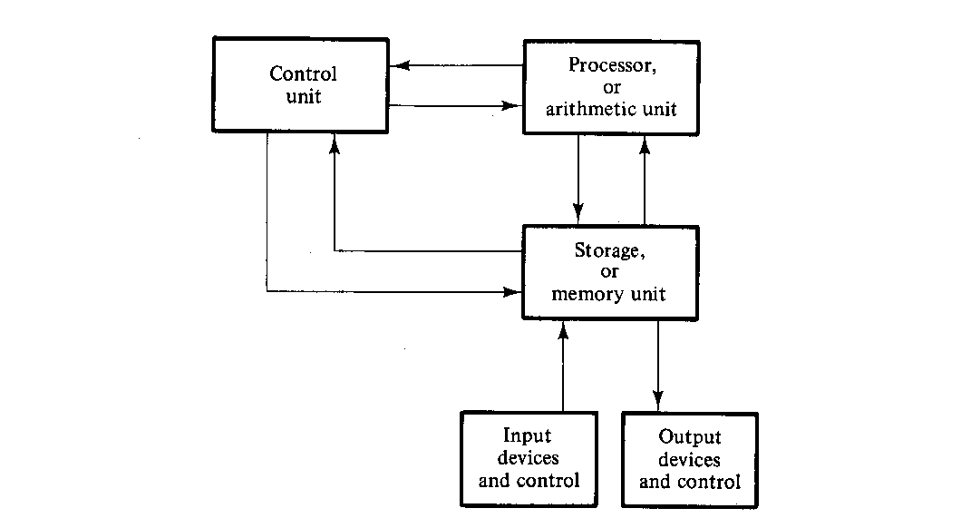
Block Diagram of Digital Computer

Slide 4
Binary Digital Signal
A digital signal is a signal that is being used to represent data as a sequence of discrete values
These values are binary values
Binary values are represented abstractly by:
0 and 1
False (F) and True (T)
Low (L) and High (H)
On and Off

Slide 5
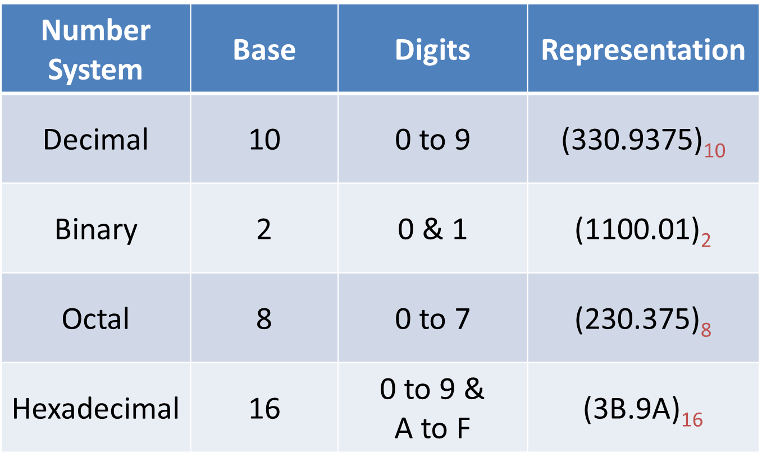
Number Systems

Slide 6
Number Base Conversions
Decimal to Binary
Decimal to Octal
Decimal to Hexadecimal
Binary to Decimal
Octal to Decimal
Hexadecimal to Decimal
Binary to Hexadecimal
Hexadecimal to Binary
Binary to Octal
Octal to Binary
Octal to Hexadecimal
Hexadecimal to Octal

Slide 7


Decimal to Binary
${(13)}_{10}$
$${=(1101)}_{2}$$
2
13
1
2
6
0
2
3
1
1

Slide 8




Decimal to Binary
$\text{(}\text{10}\text{.25}\text{)}\text{10}$
$${= (1010.01)}_{2}$$
2
0
 | 10
2
5
1
$${{(10)}_{10}= (1010)}_{2}$$
2
2
0
1
Fractional Part:
0.25 * 2 = 0.50
0.50 * 2 = 1.00
$$\text{(}\text{0}\text{.}\text{25}\text{)}\text{10}{= (0.01)}_{2}$$

Slide 9



Decimal to Binary
(32$\text{)}\text{10}$
(52.25$\text{)}\text{10}$
$${= (100000)}_{2}$$
$${= (110100.01)}_{2}$$

Slide 10
Decimal to Binary
2³
2²
2¹
2⁰
2³
2²
2¹
2⁰
0
1
2
3
4
5
6
7
8
9
10
11
12
13
14
15
0000
1000
0001
1001
0010
1010
0011
1011
0100
1100
0101
1101
0110
1110
0111
1111

Slide 11
Decimal to Octal
(105)₁₀
= (151)₈
8
1
 | 105
8
13
5
1

Slide 12

Decimal to Octal
(10.25)₁₀
= (12.2)₈
8
2
 | 10
1
(10)₁₀ = (12)₈
Fractional Part:
0.25*8 = 2.00
$$\text{(}\text{0.25}\text{)}\text{10}{= (0.2)}_{8}$$

Slide 13
Decimal to Octal
(37)₁₀
(255.5)₁₀
= (45)₈
= (377.4)₈

Slide 14
Decimal to Hexadecimal
(86)₁₀
= (56)₁₆
0 to 9 & A to F
16
6
 | 86
5

Slide 15
Decimal to Hexadecimal
(193)₁₀
= (C1)₁₆
10 | A
11 | B
12 | C
13 | D
14 | E
15 | F
16
1
 | 193
12

Slide 16
Decimal to Hexadecimal
= (4F7.5EB8..)₁₆
(1271.37)₁₀
Fractional Part:
0.37*16 = 5.92
0.92*16 = 14.72
0.72*16 = 11.52
0.52*16 = 8.32…
16
7
 | 1271
16
79
15
4
(1271)₁₀ = (4F7)₁₆
(0.37)₁₀ = (5EB8..)₁₆

Slide 17
Decimal to Hexadecimal
(37)₁₀
(255.5)₁₀
= (25)₁₆
= (FF.8)₁₆

Slide 18
Binary to Decimal
(1101)₂
= 1 x 2³ + 1 x 2² + 0 x 2¹ + 1 x 2⁰
= 8 + 4 + 0 + 1
= (13)₁₀
1
1
0
1
2³
2²
2¹
2⁰

Slide 19
Binary to Decimal
(1010.01)₂
= 1x2³ + 0x2² + 1x2¹ + 0x2⁰ + 0x2⁻¹ + 1x2⁻²
= 8 + 0 + 2 + 0 + 0 + 0.25
= (10.25)₁₀
1
0
1
0
0
1
2³
2²
2¹
2⁰
2⁻¹
2⁻²

Slide 20
Binary to Decimal
(10101)₂
(1111.11)₂
= (21)₁₀
= (15.75)₁₀

Slide 21
Octal to Decimal
(37)₈
= 3 x 8¹ + 7 x 8⁰
= 24 + 7
= (31)₁₀
3
7
8¹
8⁰

Slide 22
Octal to Decimal
(12.2)₈
= 1 x 8¹ + 2 x 8⁰ +2 x 8⁻¹
= 8 + 2 + 2(0.125)
= (10.25)₁₀
1
2
2
8¹
8⁰
8⁻¹

Slide 23
Octal to Decimal
(76)₈
(41.26)₈
= (62)₁₀
= (33.34375)₁₀

Slide 24
Hexadecimal to Decimal
(12A)₁₆
= 1 x 16² + 2 x 16¹ + 10 x 16⁰
= 256 + 32 + 10
= (298)₁₀
1
2
10
16²
16¹
16⁰

Slide 25
Hexadecimal to Decimal
(AD2.4)₁₆
= 10 x 16² + 13 x 16¹ + 2 x 16⁰ + 4 x 16⁻¹
= 2560 + 208 + 2 + 0.25
= (2770.25)₁₀
10
13
2
1
16²
16¹
16⁰
16⁻¹

Slide 26
Hexadecimal to Decimal
(76)₁₆
(4A.26)₁₆
= (118)₁₀
= (74.1484375)₁₀

Slide 27
Octal to Binary
(67)₈
(25)₈
(42.254)₈
= ( )₂
110
111
= ( )₂
= (10101)₂
010
101
010
101
100
= ( . )₂
100
010
= (100010.0101011)₂

Slide 28
Binary to Octal
= ( )₈
7
5
(111101)₂
(11101)₂
(1101101.11011)₂
= (011101)₂
= ( )₈
3
5
= (001101101.110110)₂
= (155.66)₈

Slide 29
Hexadecimal to Binary
1000
(F8)₁₆
(A21.A4)₁₆
(12.4)₁₆
= ( )₂
1111
0010
0001
= ( . )₂
1010
1010
0100
= (101000100001.101001)₂
0010
= ( . )₂
0001
0100
= (10010.01)₂

Slide 30
Binary to Hexadecimal
0011
0010
( )₂
1111
(1101101101111.01001011)₂
= (F32)₁₆
0001
0010
( . )₂
1001
1001
1100
= (912.9C)₁₆
= (0001101101101111.01001011)₂
= (1B6F.4B)₁₆

Slide 31
Hexadecimal to Octal
= (10100001)₂
Hexadecimal to Binary
(A1)₁₆
(F2.01)₁₆
= (010100001)₂
= (241)₈
Binary to Octal
= (11110010 . 00000001)₂
= (011110010 . 000000010)₂
= (362.002)₈

Slide 32
Octal to Hexadecimal
= (101111011)₂
Octal to Binary
(573)₈
(1.01)₈
= (000101111011)₂
= (17B)₁₆
Binary to Hexadecimal
= (001.000001)₂
= (0001.00000100)₂
= (1.04)₁₆

Slide 33
Number Base Conversions
Decimal to Binary
Decimal to Octal
Decimal to Hexadecimal
Binary to Decimal
Octal to Decimal
Hexadecimal to Decimal
Binary to Hexadecimal
Hexadecimal to Binary
Binary to Octal
Octal to Binary
Hexadecimal to Octal
Octal to Hexadecimal

Slide 34
Arithmetic Operations on Binary Numbers
Binary Addition
Binary Subtraction
Binary Multiplication
Binary Division

Slide 35
Binary Addition
1 1 0 1 1 1
+ 1 0 1 0 1 0
A | B | Carry | Sum
0 | 0 | 0 | 0
0 | 1 | 0 | 1
1 | 0 | 0 | 1
1 | 1 | 1 | 0

Slide 36
Binary Addition
1 1 1 1 0 1
+ 1 0 1 1 1
1 1 1 1 1 1
+ 1 1 1 0 1 1

Slide 37
Binary Addition
1 1 1 . 1 0 1
+ 1 1 0 . 1 1 1
1 0 1 1 0 1 . 1 0 1
+ 1 1 1 0 1 . 1 0 1

Slide 38
Binary Subtraction
1 1 0 0 1
- 1 0 1 0 1
A | B | Difference | Borrow
0 | 0 | 0 | 0
0 | 1 | 1 | 1
1 | 0 | 1 | 0
1 | 1 | 0 | 0

Slide 39
Binary Subtraction
1 0 0 1 1 0 1
- 1 0 1 1 1
1 0 0 1 0 1
- 1 1 0 1 0

Slide 40
Binary Subtraction
1 1 1 . 0 1
- 1 0 1 . 1 0
1 0 0 1 1 0 1 . 0 1 0
- 1 1 0 1 0 1 . 1 1 1

Slide 41
Binary Multiplication
1 0 1 1 1
* 1 0 1 0
1 0 1 1 1 0 0 0
0 0 0 0 0 0 0
1 0 1 1 1 0
0 0 0 0 0
A | B | Multiply
0 | 0 | 0
0 | 1 | 0
1 | 0 | 0
1 | 1 | 1
1
1
1
0
0
1
1
0

Slide 42
Binary Multiplication
1 1 0 1 1
* 1 0 1
1 0 1 1 0 1
* 1 1 0 1

Slide 43
Binary Division
1
1
1
1 0 0
1 1 1 1 1
1 0 1
1 0 0 1 0 1 1 1
1 0 0
0 1 1
1
1 0 0
0 1 1
1
1 0 0
0 1 1

Slide 44
Complements
There are two types of complements for each base-r system:
Diminished radix complement - (r-1)’s Complement
Radix complement - r’s Complement

Slide 45
1’s Complement
00100 →
10010111 →
100101.010 →

Slide 46
2’s Complement
1101101 →
10101 →
1001001.01 →
101.101 →

Slide 47
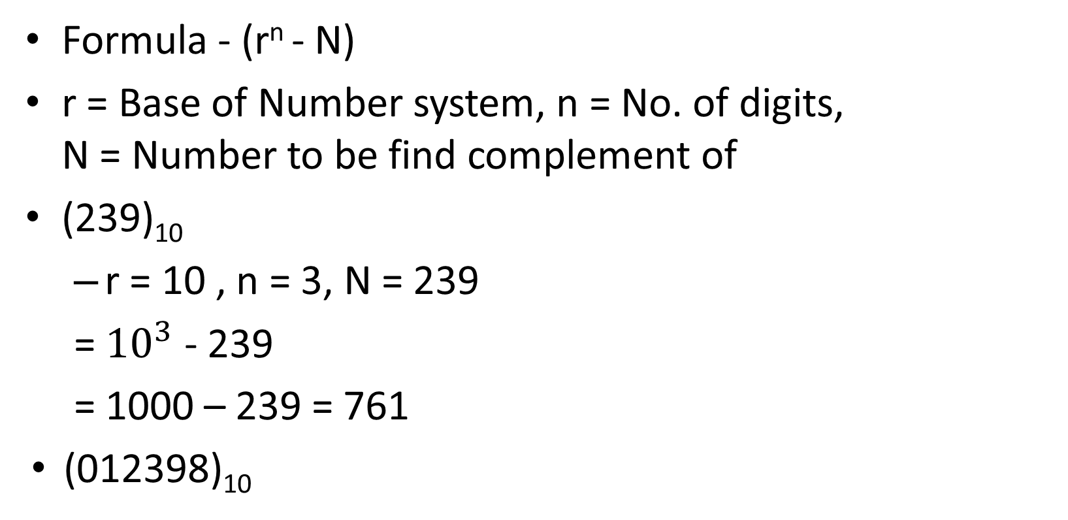
10’s Complement
Formula - (r^{n} - N)
r = Base of Number system, n = No. of digits, N = Number to be find complement of
(239)₁₀
r = 10 , n = 3, N = 239
= ${10}^{3}$ - 239
= 1000 – 239 = 761
(012398)₁₀

Slide 48
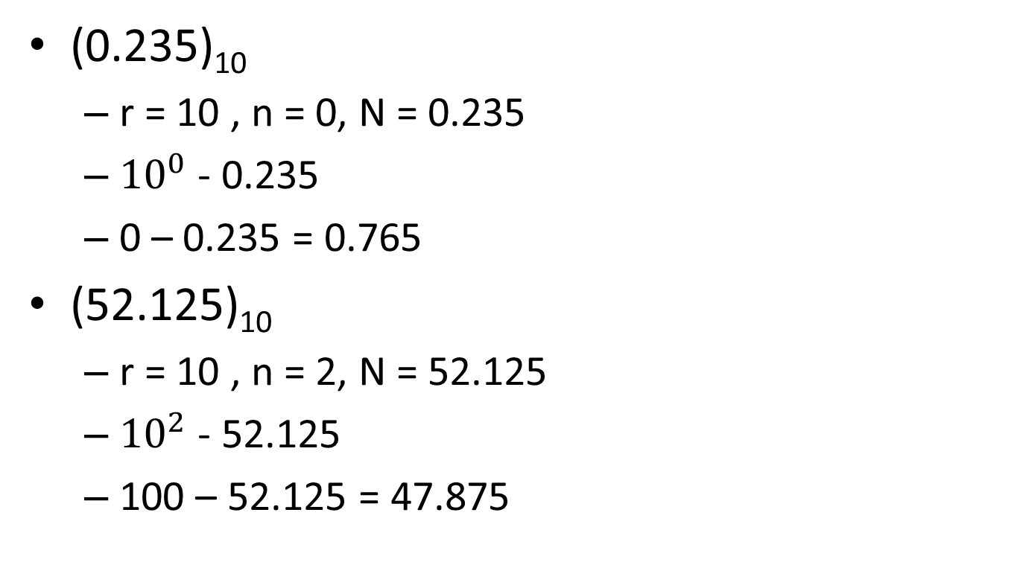
10’s Complement
(0.235)₁₀
r = 10 , n = 0, N = 0.235
${10}^{0}$ - 0.235
0 – 0.235 = 0.765
(52.125)₁₀
r = 10 , n = 2, N = 52.125
${10}^{2}$ - 52.125
100 – 52.125 = 47.875

Slide 49
9’s Complement
Formula - (r^{n} – r^{-m}) – N
r = Base, n = int no. of digits, m = float no. of digits, N = Number
(239)₁₀
r = 10, n = 3, m = 0, N = 239
(10³ – 10⁻⁰ – 239)
1000 – 1 – 239 = 760
(521)₁₀

Slide 50
9’s Complement
(37.135)₁₀
r = 10, n = 2, m = 3, N = 37.135
(10² - 10⁻³ - 37.135)
100 - 0.001 - 37.135 = 62.864
(0.375)₁₀
r = 10, n = 0, m = 3, N = 0.375
(10⁰ - 10⁻³ – 0.375)
1 - 0.001 – 0.375 = 0.624

Slide 51
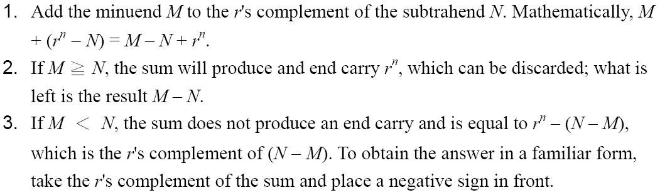
Subtraction with Complements
The subtraction of two n-digit unsigned numbers M – N in base r can be done as follows:

Slide 52
Subtraction using 10's complement
69245 – 14258
Find 10’s complement of 14258 =
Add 69245 and 85742
Discard the carry
= 54987
85742
6 9 2 4 5
+
8 5 7 4 2
1 5 4 9 8 7

Slide 53
Subtraction using 10's complement
2. 72532 – 3250
Find 10’s complement of 03250 =
Add 72532 and 96750
Discard the carry
= 69282
96750
7 2 5 3 2
+
9 6 7 5 0
1 6 9 2 8 2

Slide 54
Subtraction using 10's complement
3. 2341 – 4237
Find 10’s complement of 4237 =
Add 2341 and 5763
As no carry is generated, find 10’s complement of 8104 =
= -1896
5763
2 3 4 1
+
5 7 6 3
8 1 0 4
1896

Slide 55
Subtraction using 10's complement
4. 3250 – 72532
Find 10’s complement of 72532 =
Add 3250 and 27468
As no carry is generated, find 10’s complement of 30718 =
= -69282
27468
0 3 2 5 0
+
2 7 4 6 8
3 0 7 1 8
69282

Slide 56
Subtraction using 2's complement
1. 1010100 - 1000011
Find 2’s complement of 1000011 =
Add 1010100 and 0111101
Discard the carry
= 10001
0111101
1 0 1 0 1 0 0
+
0 1 1 1 1 0 1
1 0 0 1 0 0 0 1

Slide 57
Subtraction using 2's complement
2. 1000011 – 1010100
Find 2’s complement of 1010100 =
Add 1000011 and 0101100
As no carry is generated, find 2’s complement of 1101111 =
= -10001
0101100
1 0 0 0 0 1 1
+
0 1 0 1 1 0 0
1 1 0 1 1 1 1
0010001

Slide 58
Subtraction with Complements
Subtraction of unsigned numbers can also be done by means of the (r − 1)'s complement. Remember that the (r − 1) 's complement is one less then the r's complement.

Slide 59
Subtraction using 9's complement
1. 54326 – 8235
Find 9’s complement of 08235 =
Add 54326 and 91764
Add the carry to the answer
= 46091
91764
5 4 3 2 6
+
9 1 7 6 4
1 4 6 0 9 0
4 6 0 9 0
+
1
4 6 0 9 1

Slide 60
Subtraction using 9's complement
= -28114
2. 54231 – 82345
Find 9’s complement of 82345 =
Add 54231 and 17654
As no carry is generated, find 9’s complement of 71885 =
17654
5 4 2 3 1
+
1 7 6 5 4
7 1 8 8 5
28114

Slide 61
Binary Codes
The digital data is represented, stored and transmitted as group of binary bits.
This group is also called as binary code.
The binary code is represented by the number as well as alphanumeric letter.

Slide 62
BCD Code
In this code each decimal digit is represented by a 4-bit binary number. BCD is a way to express each of the decimal digits with a binary code.
A decimal number in BCD is the same as its equivalent binary number only when the number is between 0 and 9.
The binary combinations 1010 through 1111 are not used and have no meaning in BCD.

Slide 63
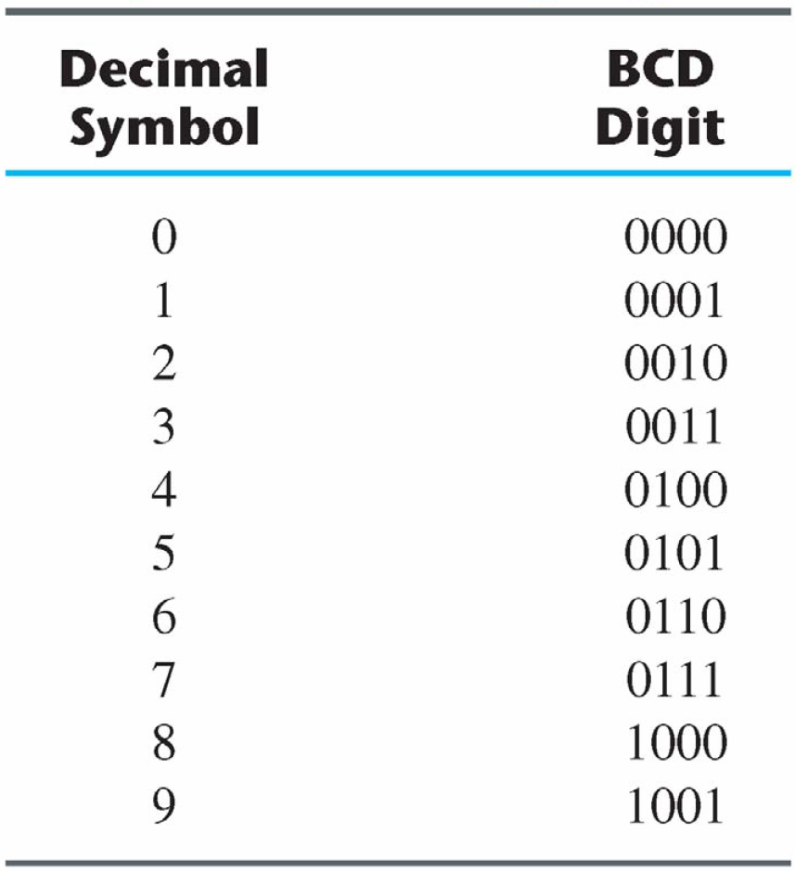
BCD Code

Slide 64

BCD Code
Example:
${\left(54\right)}_{10}$ =
${\left(185\right)}_{10}=$

Slide 65
Gray Code
Reflected Code
The advantage is that only bit in the code group changes in going from one number to the next.
Error detection.
Representation of analog data.
Low power design.
000
001
010
011
100
101
110
111

Slide 66
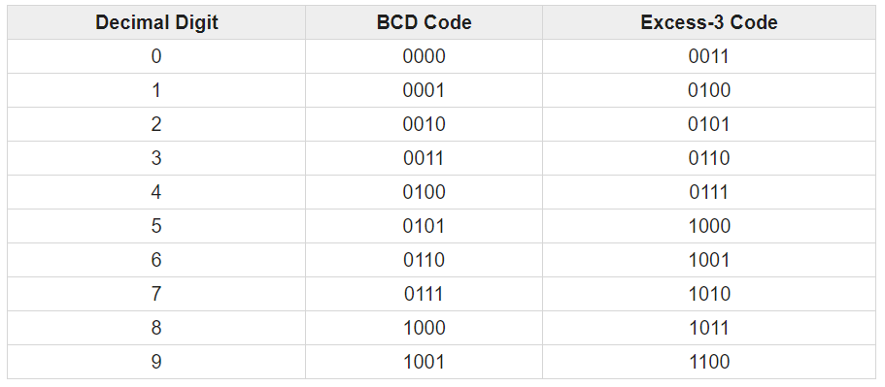
Excess 3 Code
It is a self-complementary binary coded decimal (BCD) code.
We need to add 3 to both digit in the decimal number then convert into BCD

Slide 67

Excess 3 Code
Example:
${\left(23\right)}_{10}$ =
${\left(\text{15.46}\right)}_{10}=$

Slide 68
ASCII Codes
American Standard Code for Information Interchange
A popular code used to represent information sent as character-based data.
It uses 7-bits to represent:
94 Graphic printing characters.
34 Non-printing characters.
Some non-printing characters are used for text format (e.g. BS = Backspace, CR = carriage return).
Other non-printing characters are used for record marking and flow control (e.g. STX and ETX start and end text areas).

Slide 69
Error-Detecting Code
To detect errors in data communication and processing, an eighth bit is sometimes added to the ASCII character to indicate its parity.
A parity bit is an extra bit included with a message to make the total number of 1's either even or odd.
Example:
Consider the following two characters and their even and odd parity:

Slide 70
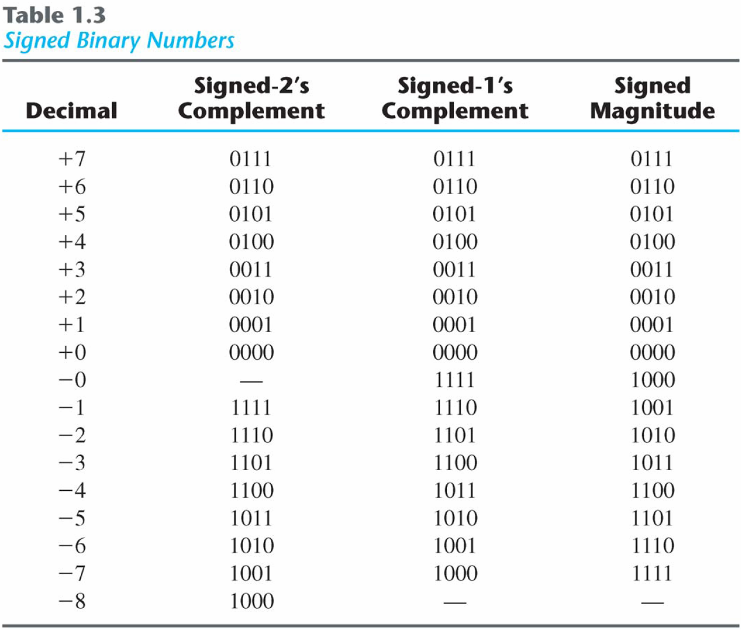
Signed Binary Numbers
The convention is to make the
sign bit 0 for positive and
1 for negative.

